Slide 1

Daycare Program
CSYE 6200 WentaoPu
Xiaoge Zhang
Qianru Yi
Mengfan Shi
Huai Huang
PinHo Wang
Wentao Pu

Slide 2
PREFACE
Daycare is a sweet assistant to help the school managing classes, students and teachers.

Slide 3
Daycare Program Review
Our Teamwork
CONTENTS
Daycare Demo

Slide 4
Daycare Program Review
Program Function，UML & Some Features

Slide 5


Review - About Program
Function
Capture Data
Track registration
Track immunization
People Management
Student Name, age
Parents name
GUI and CSV File input
Track annual registration renewal
Track immunization anniversaries
Assign students to Teachers according to state regulations
Assign students and Teachers to classrooms according to state regulations
PPT模板下载：www.1ppt.com/moban/ 行业PPT模板：www.1ppt.com/hangye/
节日PPT模板：www.1ppt.com/jieri/ PPT素材下载：www.1ppt.com/sucai/
PPT背景图片：www.1ppt.com/beijing/ PPT图表下载：www.1ppt.com/tubiao/
优秀PPT下载：www.1ppt.com/xiazai/ PPT教程： www.1ppt.com/powerpoint/
Word教程： www.1ppt.com/word/ Excel教程：www.1ppt.com/excel/
资料下载：www.1ppt.com/ziliao/ PPT课件下载：www.1ppt.com/kejian/
范文下载：www.1ppt.com/fanwen/ 试卷下载：www.1ppt.com/shiti/
教案下载：www.1ppt.com/jiaoan/
字体下载：www.1ppt.com/ziti/

Slide 6
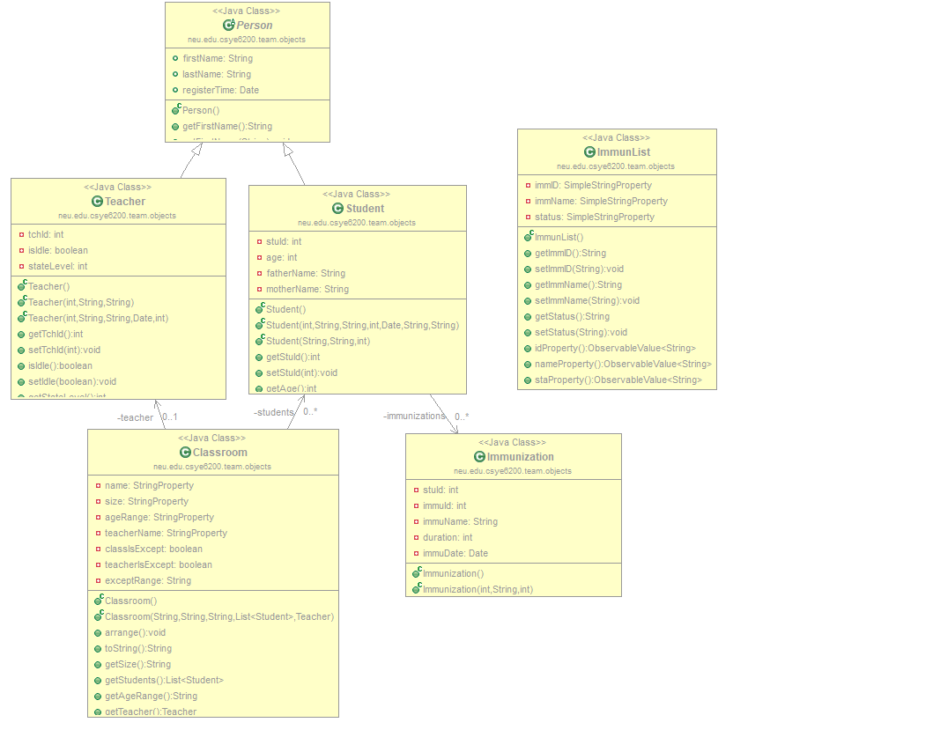
Review - Program UML

Slide 7
Review - My DayCare Features
Use MVC - Model View Controller Design Pattern Divide model and controller separately
Use Javafx
Use Material Design Style

Slide 8
Our Teamwork
Task Assignment, Schedule, Individual work

Slide 9
Our Teamwork
Xiaoge Zhang - Administrator Part
Qianru Yi - Student & Immunization Part
Mengfan Shi - GUI Main Design
Huai Huang – Base Class, Interfaces, Data Management
PinHo Wang - Teacher Part
Wentao Pu - Project Management
·

Slide 10
Our Teamwork – My Part
Project Management
Merge Separate Parts together
Enhance GUI

Slide 11
Our Teamwork – Timeline
learn JavaFX，build basic data management, design program architecture
enhance each single parts, fix bug and program test
September
Before October 15
After October 15
November
start to implement each single part of the program: Administrator, Teacher, Student, start to do UI design
merge together, improve program GUI

Slide 12
Our Teamwork – Huang Huai
Writing CSV files
To write data into csv files, I use java reflection to build up data sets. The key code in FileIO. writeFile(List<T> data, Class<T> clazz, String dataType) is to load an image of the data type, and get an array of its declared fields (includes its super class fields), those fields name will be written into csv file as the column head; then use toString() to convert object into specific data String, for loop the data list, write into file line by line. To make sure the order of data and column head are matched, toString() method outputs fields value in the same order as they are declared. This is the only rule needs to be obeyed when a concrete class is designed to be written in csv file.
Because of using image of data type instead of using specific class type, FileIO.writeFile(…) suits to every concrete class follow the rule.

Slide 13
Our Teamwork – Huang Huai
Reading CSV files
To read data in csv files, I also use java reflection to handle it. It’s much easier than write data into csv. The main idea of FileIO.readFileOfMap(Class<T> clazz, String dataType) is that I firstly read the column head line and separate them by comma, get an array of field keys; then read each line of the data list, suits them into the specific field key. After this operation I get a map of data. Finally, check the key name with the field name in the concrete class, fill in the value if they are matched. Reading operation won’t cause any exception even if the csv file is empty because if there is no value, no operation will be taken.
Both of the reading and writing function are thread safe. They use synchronized to lock the data while operating.

Slide 14
Our Teamwork – Huang Huai
Way to think
01
02
03
Which type
Operation
Return value
Make sure the type that I need to handle with. Student’s data management will only handle student data.
What kind of operation we need to handle a certain data type. To different type of data, this thing can have significant difference.
After invoking a method, what kind of data will return. In general, this kind of thing must be predefined and won’t be changed.

Slide 15
Our Teamwork – Huang Huai
Steps to create
01
02
03
04
Implements
Methods used
Call FileIO
Return value
Implements DataManagement interface, define the general type to the specific data type
Add comment to unused methods. Specifically state out the parameters meaning
Each data management class can’t directly access the csv file. It can only use methods in FileIO to do each data operation
Carefully define the return value and state out the meaning of it.

Slide 16
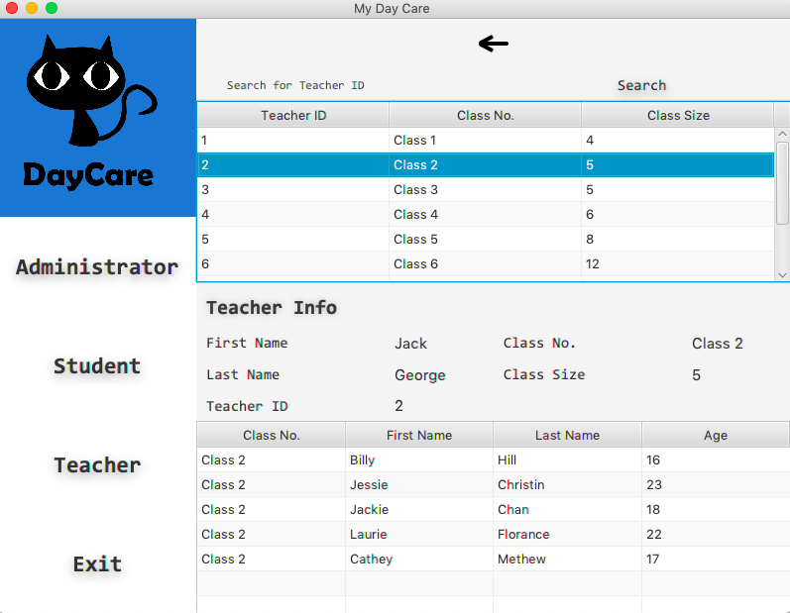

Our Teamwork – PingHo Wang
Part 1

Slide 17
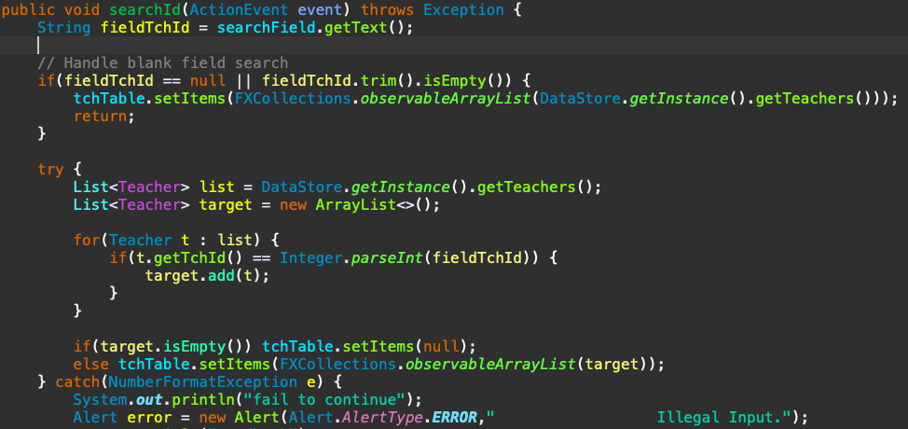
Our Teamwork – PingHo Wang
Part 2

Slide 18

Our Teamwork – PingHo Wang
Part 3

Slide 19

Our Teamwork – PingHo Wang
Part 4

Slide 20
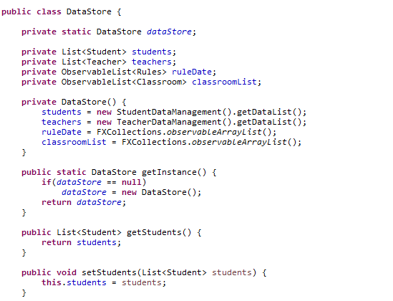
Our Teamwork – Xiaoge Zhang
Create

Slide 21
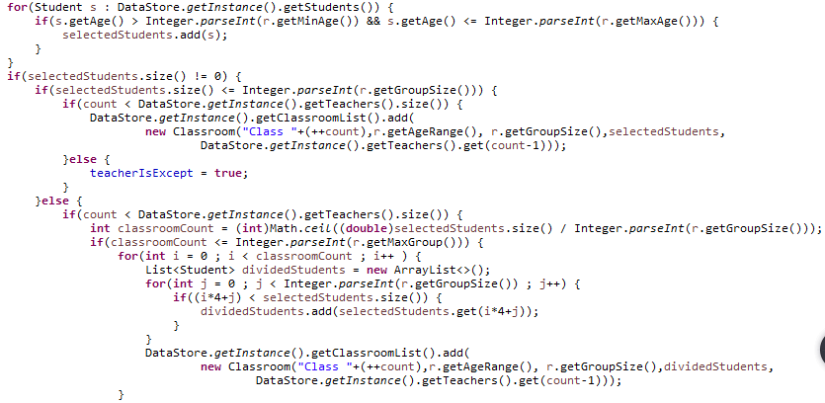
Our Teamwork – Xiaoge Zhang
Assign

Slide 22
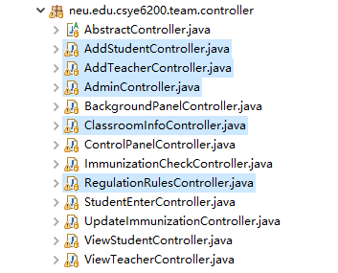
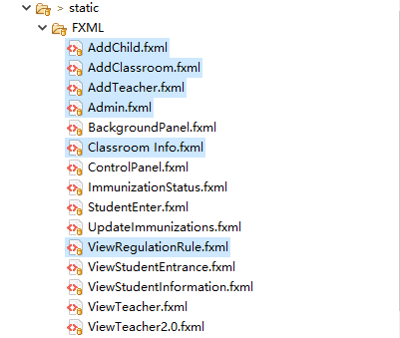
Our Teamwork – Xiaoge Zhang
Add

Slide 23
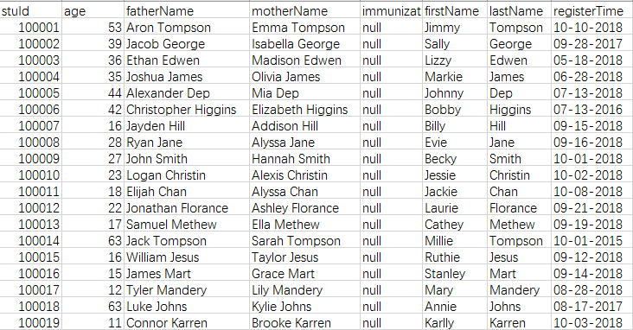
Our Teamwork – Xiaoge Zhang
Associate

Slide 24
Our Teamwork – Mengfan Shi
Our daycare project is achieved by JAVAFX, we use Screen Builder to design our UI.
The target users are mainly three groups of people: Administrator, Student and Teacher.
Administrator: add new member, manage the classrooms
Student: see personal information, check and update immunization record
Teacher: see personal information, show class and student detail
Main Aim

Slide 25
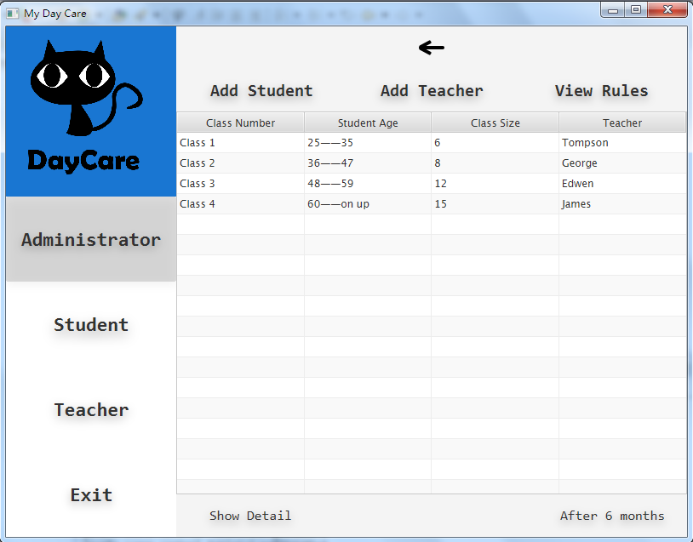
Our Teamwork – Mengfan Shi
Administrator
See all classrooms’ situation;
Show detail to see each classroom’s information;
Change classes every 6 months;
Add students and teachers to the system;
View the rules to know how classrooms are assigned

Slide 26
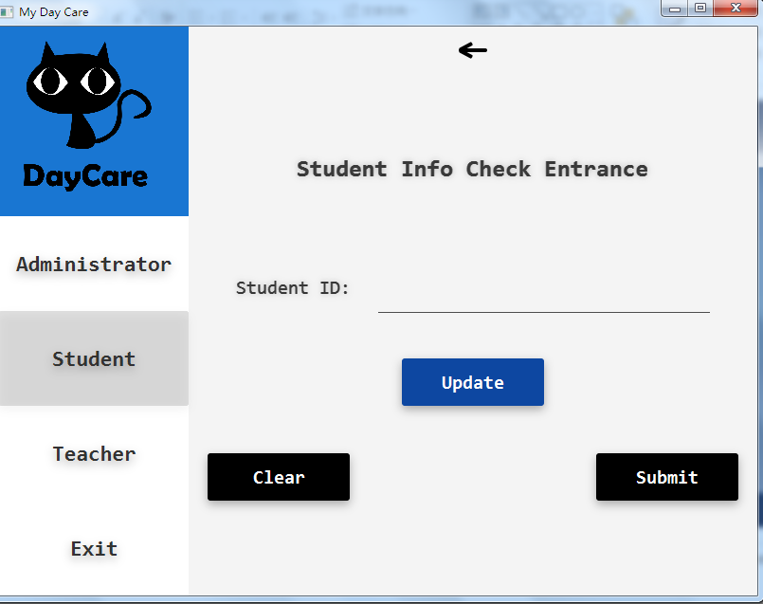
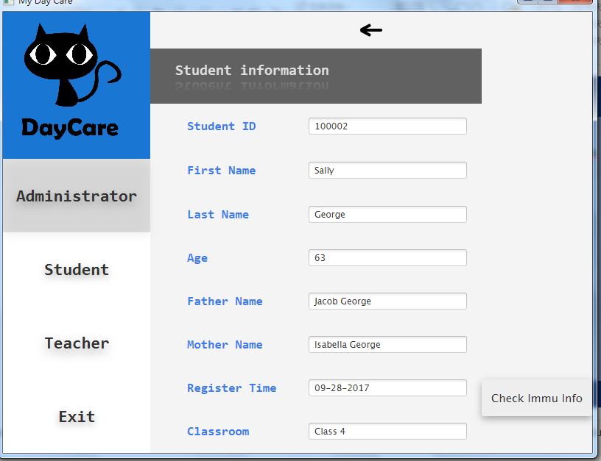
Our Teamwork – Mengfan Shi
Student
Each student use their ID to log in to see their own information and check the Immunization info;

Slide 27
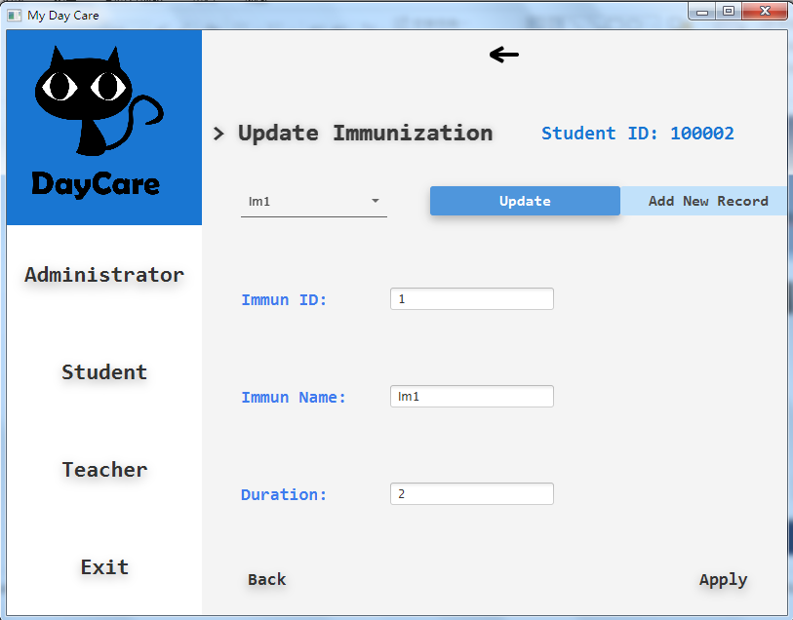
Our Teamwork – Mengfan Shi
Student
To update Immunization, students can choose from the immunization list to update the record or add new;
The duration of immunization is also listed

Slide 28
Our Teamwork – Mengfan Shi
Teacher
See all classrooms’ situation;
Show detail to see each classroom’s information;
Change classes every 6 months;
Add students and teachers to the system;
View the rules to know how classrooms are assigned

Slide 29
Our Teamwork – Qianru Yi
Student Information
• Check through Student ID
• Obtain data from csv file with student information
• The role of student has no right to modify their registered information

Slide 30
Our Teamwork – Qianru Yi
Immunization Track
All immunization records of a specific student present in a table
Student could check the details of each immunization record
Student could track the status of all immunizations in the table

Slide 31
Our Teamwork – Qianru Yi
Immunization Update
Contain two functions, the one is adding new immunization record for students
The other is updating immunization record for students, including modify the record information, and renew the immunization from the date of “today”

Slide 32
Demo
Show Daycare Program

Slide 33
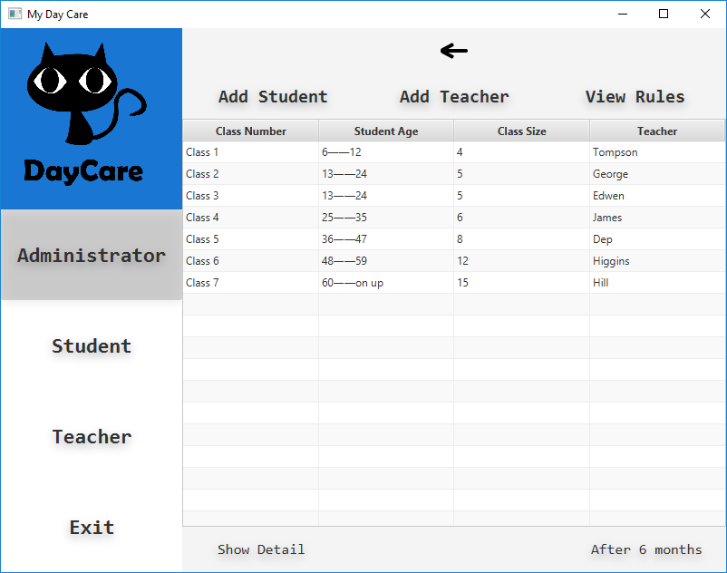

Demo - Administrator

Slide 34
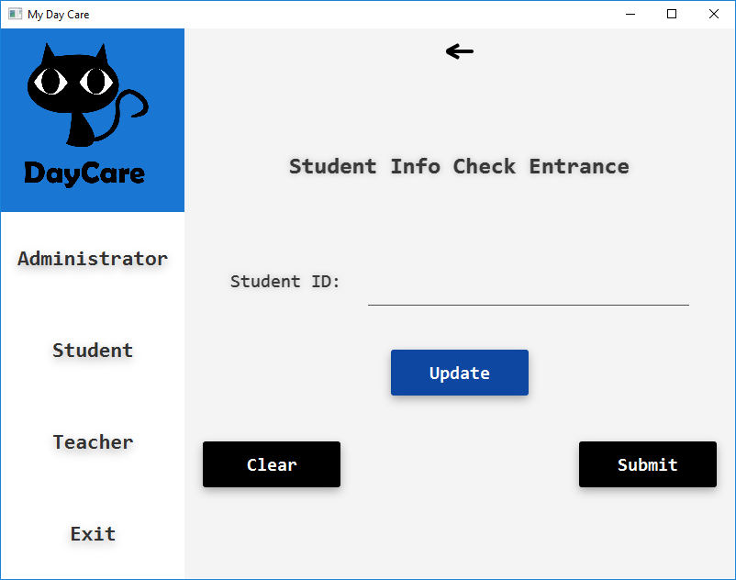
Demo - Student

Slide 35
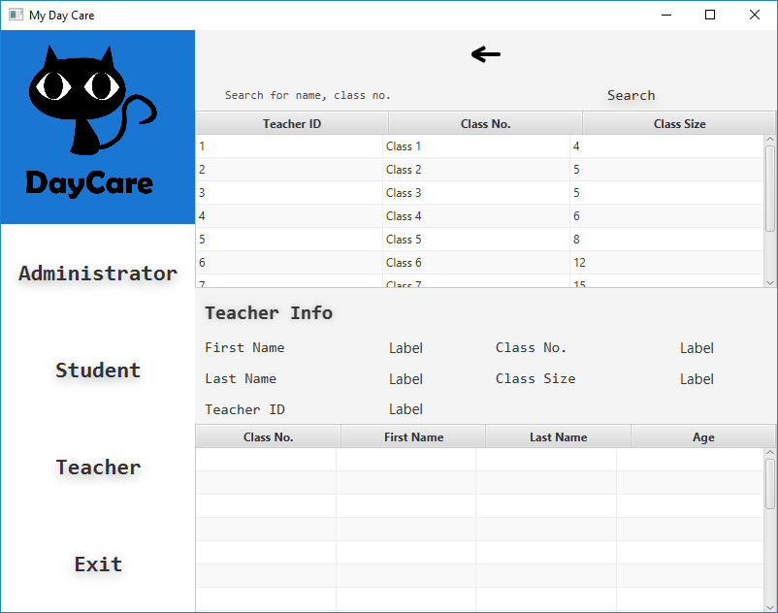
Demo – Teacher

Slide 36
Thank you for listening

